Slide 1
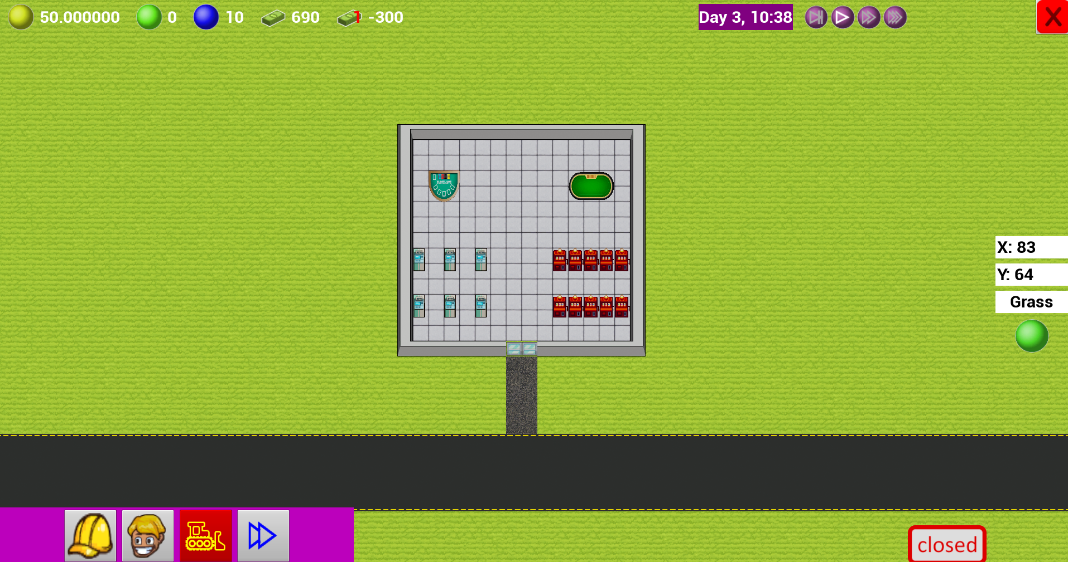
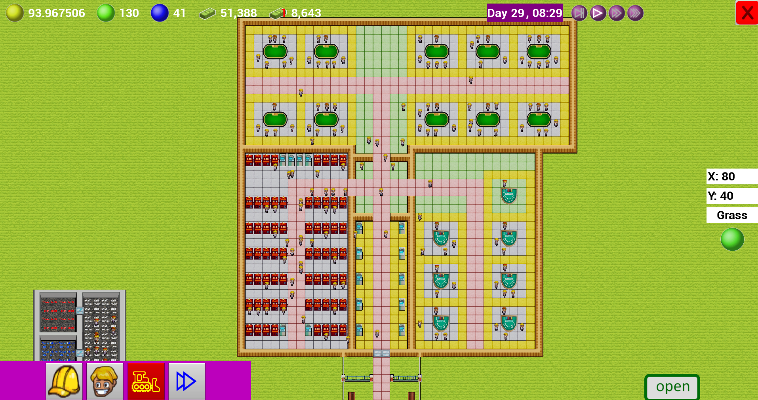

Casino Inc.
Matthieu van den Berg
140352
Graduate year Programmer

Slide 2
Index
Introduction
Goals
Influence
Specifications
Milestones
Result and conclusion

Slide 3
Introduction
Casino Inc.
Tile based Casino management game.
Building through AI.
Creativity and freedom!

Slide 4
Goals
Playable game
I want to make a playable game in the 18/20 weeks that the block takes, with at least minimum features to show off a nice portfolio piece.
Learning of new AI systems
To further my portfolio, I wanted to use a GOAP AI system for the ai, as I have not used that before, and I think that would be a good thing to have used at least once, and it’s a good system for the AI in this type of games.

Slide 5
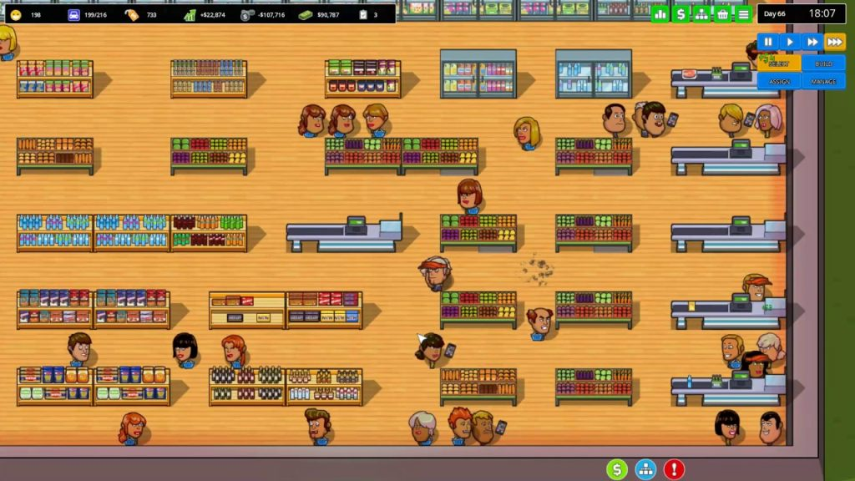
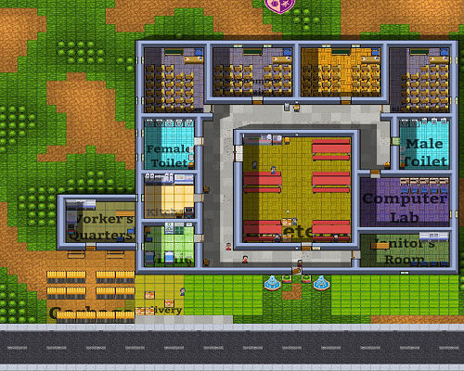
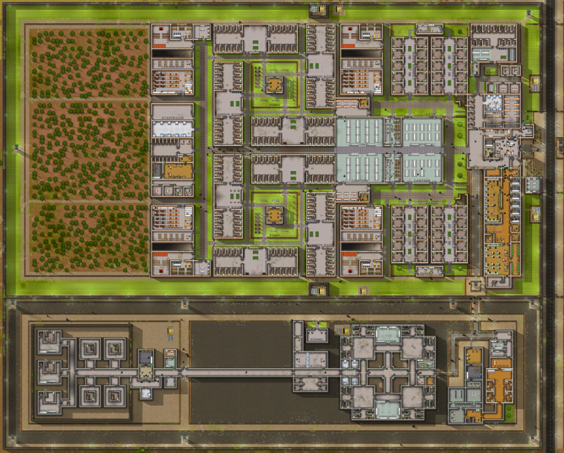
Influence
Prison Architect
Another Brick in the Mall
Academia: School simulator
Notes:
ABitM: https://gameoverblog.fr/?p=1166
Prison architect: https://www.reddit.com/r/prisonarchitect/comments/6kreea/my_first_complete_prison/
Academia: http://top-or-flop.bytefortress.de/review_academia.html

Slide 6
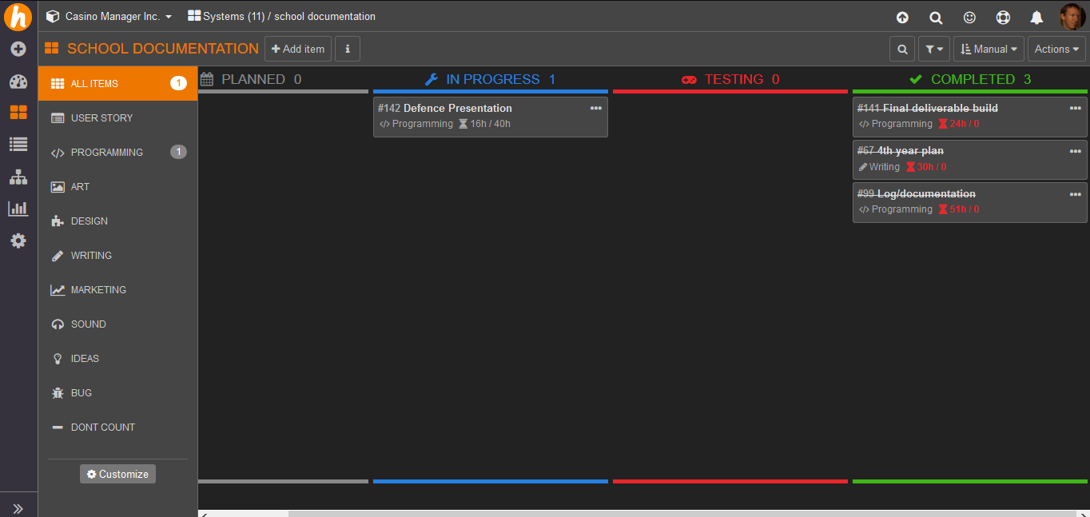
Specifications
Gameplay Loop
The player spends his money to expand the casino.
The casino is being built by the ai’s.
Guests come to play games in the casino making the player money.
Return to step 1.
Theme
Top-down Tiles.
Build your own Casino.
Motivation
Creativity.
Bigger is better.
AI decision making
GOAP.
Utility Theory.
Building system
Indirect.
player chooses.
AI carries out.
HackNPlan
Management tool.
Kanban.

Slide 7
Milestones
2D Tile map
Basic Player Interaction
Pathfinding
AI Task Manager
GOAP planner
01
02
03
04
05
Poker, Blackjack, and Slot Machines
Casino Management
Builders
Guests
Dealers
06
07
08
09
10

Slide 8
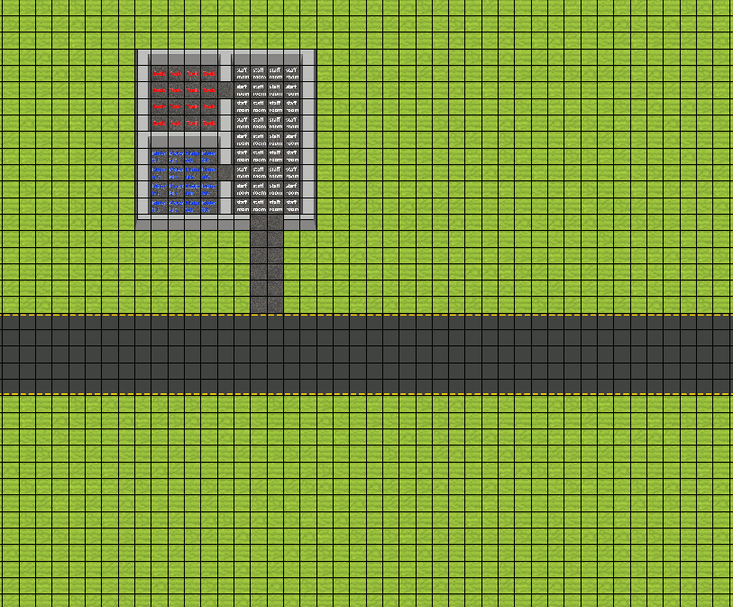
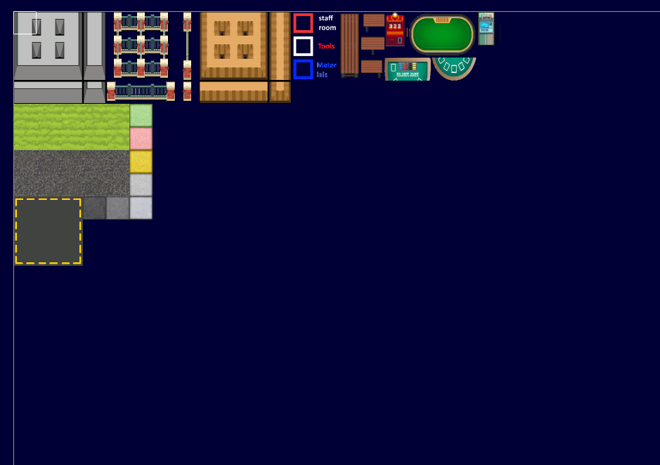
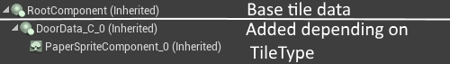
1.
2D tile map

Slide 9
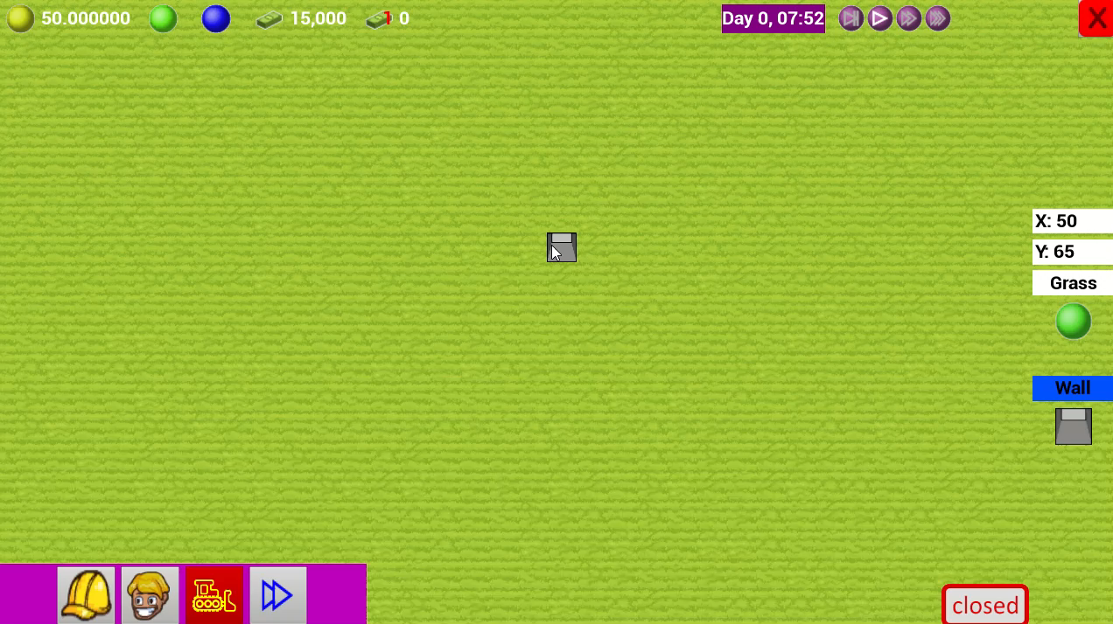
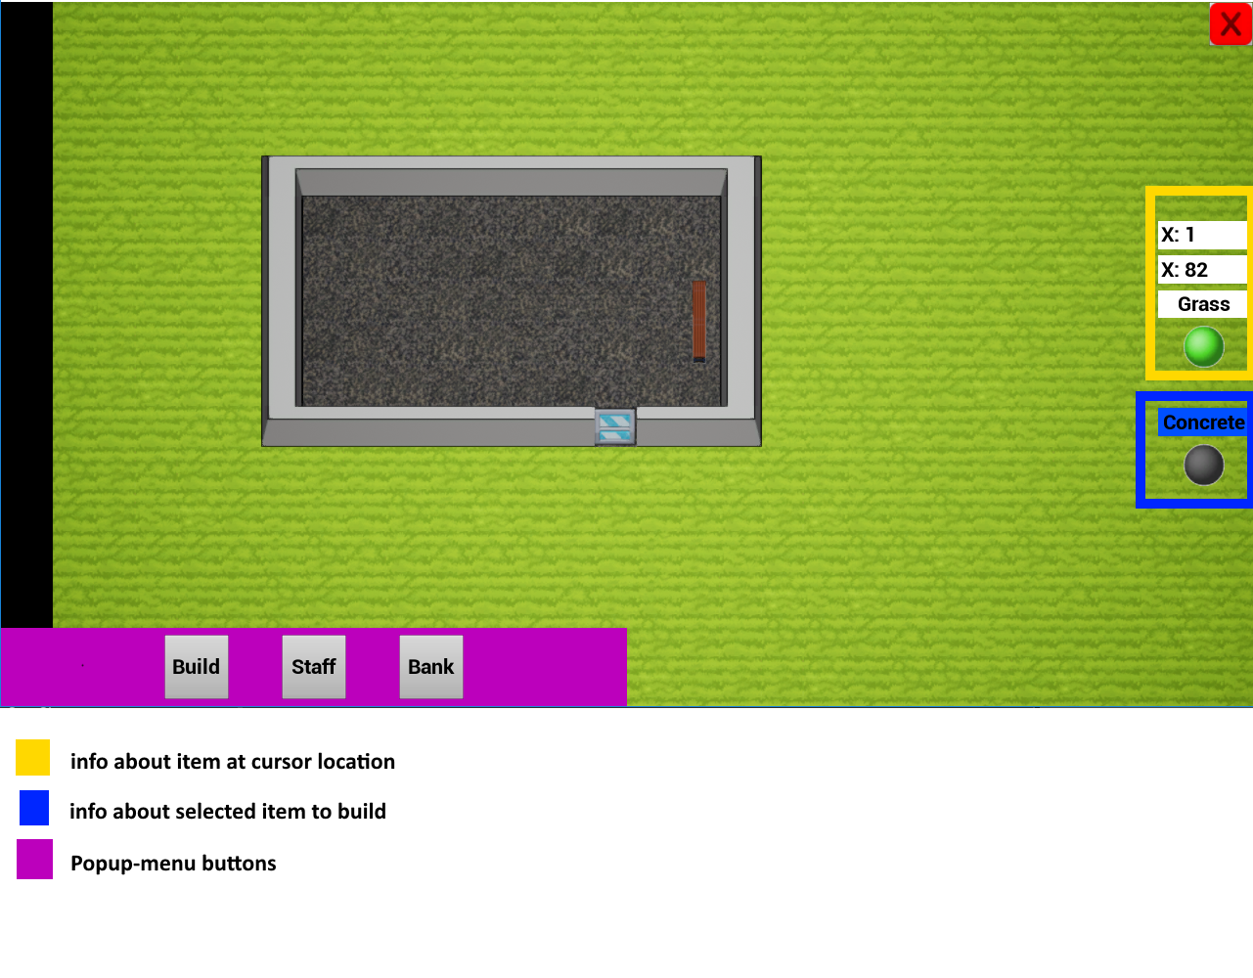
2.
Basic Player Interaction

Slide 10
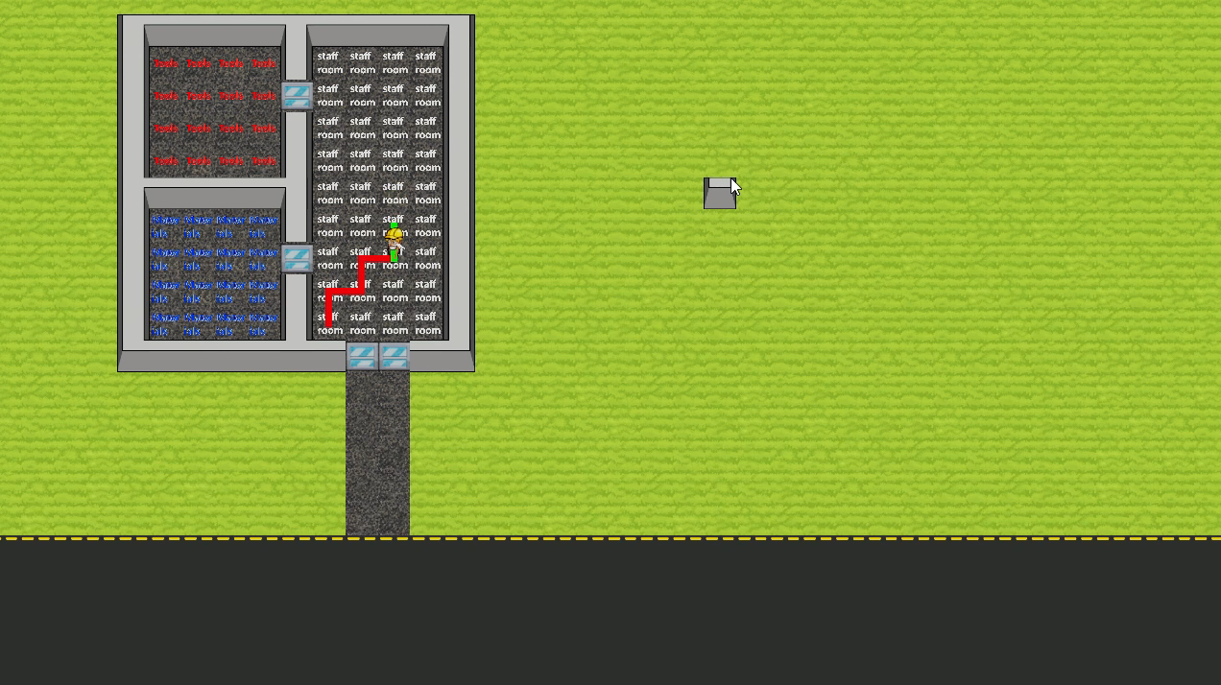
3.
Pathfinding
A*

Slide 11
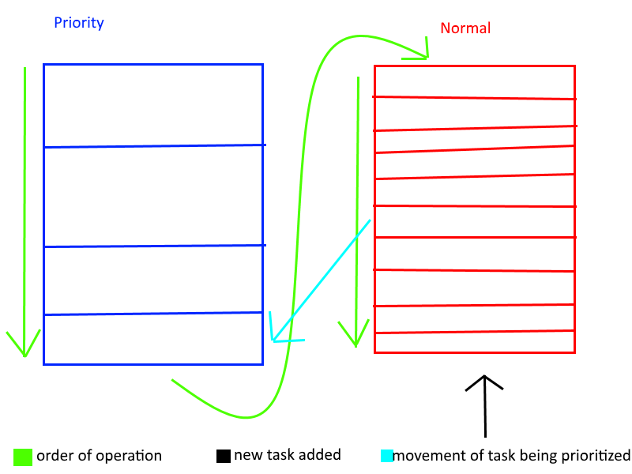
4.
AI Task Manager

Slide 12
Priority
Build Wall 3
Normal
Build wall 1
Clean trash
Build wall 2
Build wall 3
Work at poker table
Clean trash
Priority
Normal
Build wall 1
Clean trash
Build wall 2
Build wall 3
Work at poker table
Priority
Build Wall 3
Normal
Build wall 1
Clean trash
Build wall 2
Build wall 3
Work at poker table
Clean trash
Builder 1
Janitor
Builder 2
Builder 3
Dealer

Slide 13
5.
G
A
P
Goal Oriented Action Planner
O

Slide 14
Drop tools
Moves away from goal
Current state:
empty
Get Tools
+ tools
Goal state:
Tools
Materials
Get materials
+ materials
Reaches goal
Drop tools
No tools to drop
Get materials
+ materials
Get Tools
+ tools
Reaches goal
Drop materials
No materials to drop

Slide 15
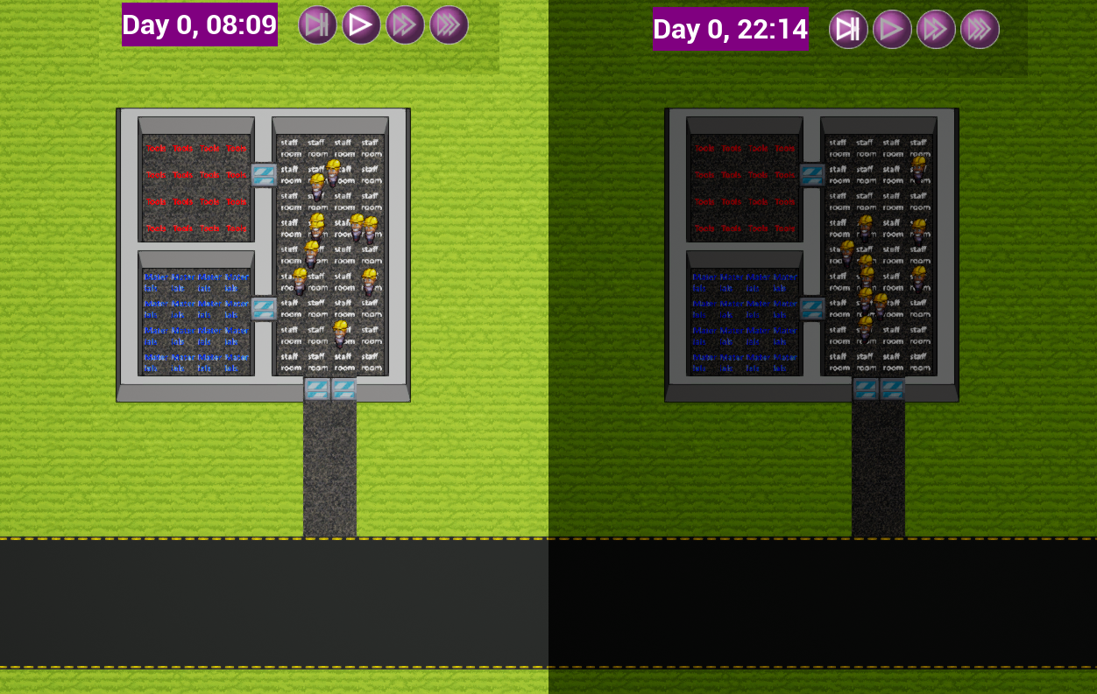
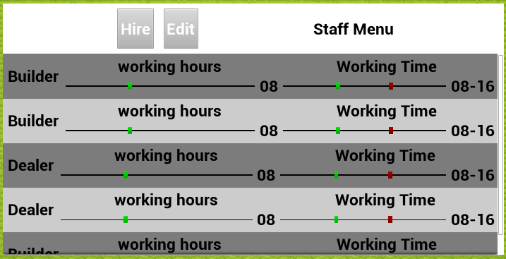
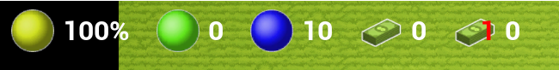
6.
Casino Management

Slide 16
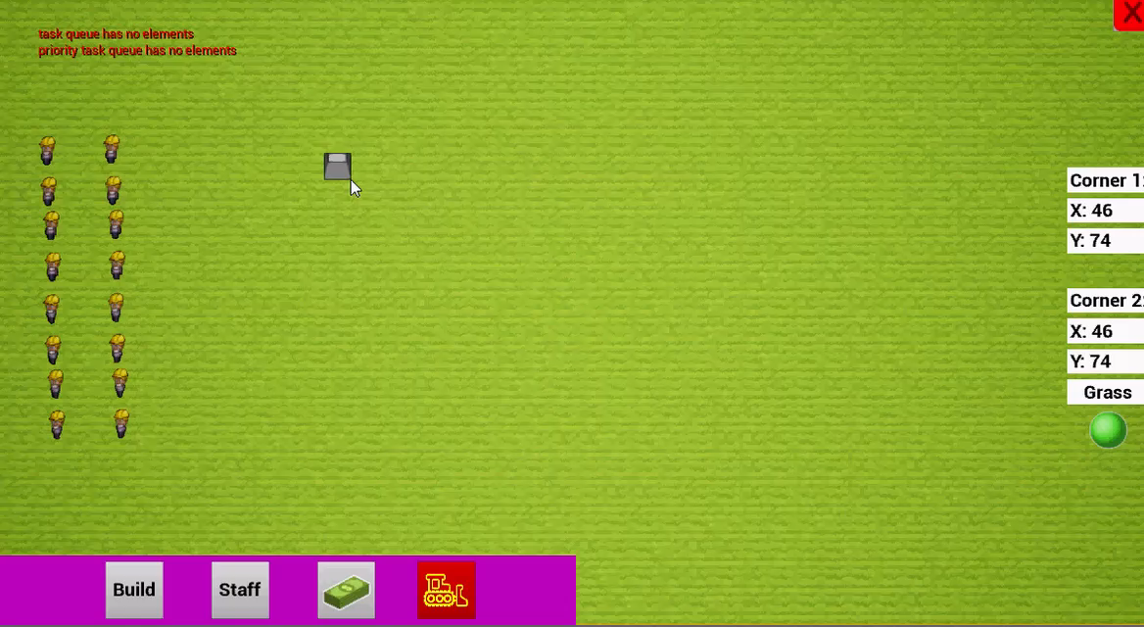

7.
Builders

Slide 17

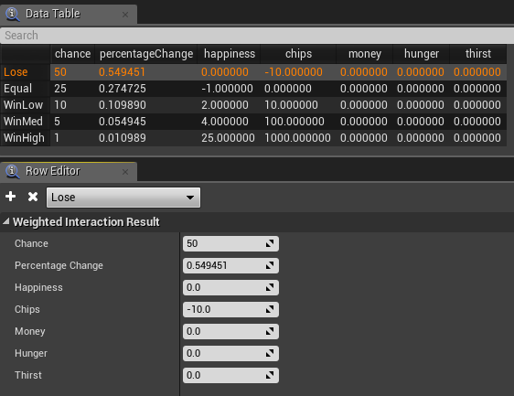
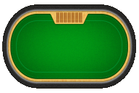

8.
Poker, Blackjack, and Slot-Machines

Slide 18

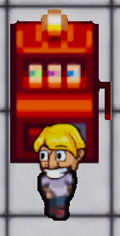
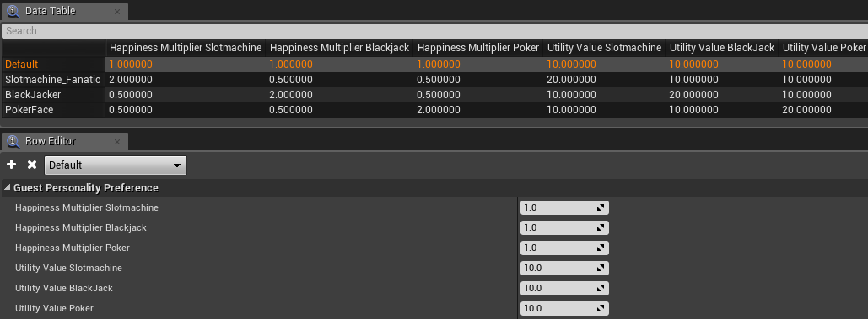
9.
Guests

Slide 19
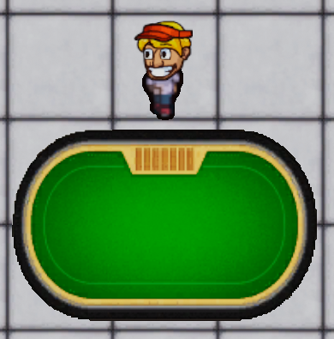

10.
Dealer

Slide 20
Results and conclusion

